Slide 1



STOP WATCH
DEPARTMENT OF ELECTRONICS
AND COMMUNICATION
ENGINEERING
A MICRO PROJECT PPT
for
22ECT31 - DIGITAL ELECTRONICS
PRESENTED BY
HARIPRASAD M - 23ECR068
KISHOREKUMAR S - 23ECR117
PRASATH R - 23ECR255

Slide 2
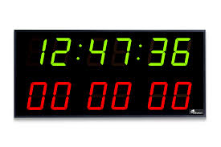
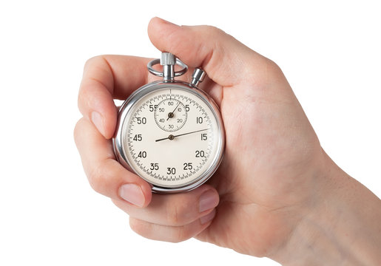
OBJECTIVE OF THE PROJECT
To design and implement a digital stopwatch capable of counting time in seconds (up to 99 seconds).
To display the elapsed time on a two-digit 7-segment display.
To control the stopwatch with Start/Stop and Reset buttons using basic electronic components.
To demonstrate the practical use of IC 4026 and 555 Timer in real-world applications.

Slide 3
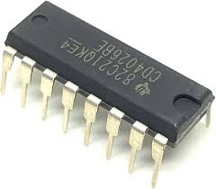
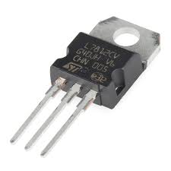
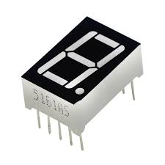
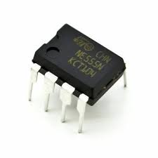
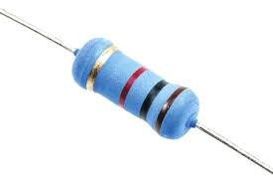
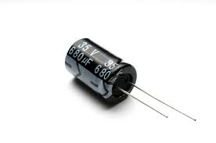
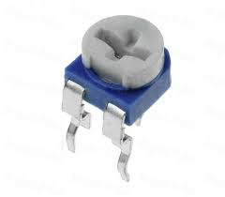
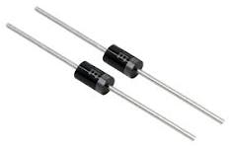
COMPONENTS INVOLVED
ICS :
4026 (x2): Decade counter and display driver.
555 Timer (x1): For clock pulse generation.
Displays :
7-Segment Displays (x2): For visualizing the time.
Buttons :
Start/Stop Button.
Reset Button.
Passive Components :
Resistors - 10k,100ohm,1k
Capacitors – 10uf,100uf,1uf
Potentiometer - 50k
Power Supply :
5V Regulator.

Slide 4
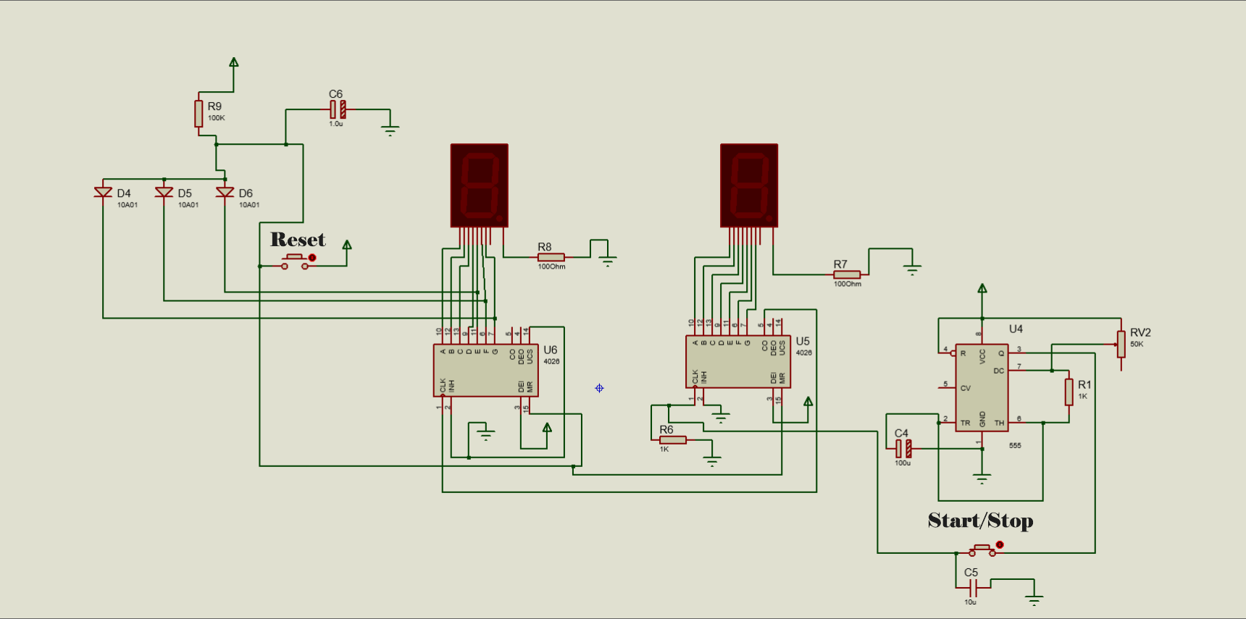
CIRCUIT DIAGRAM

Slide 5
Working Principle
How the Circuit Works:
Clock Pulse Generation:
The 555 Timer operates in astable mode to produce periodic clock pulses.
Counting Time :
The clock pulses increment the first IC 4026, which counts from 0 to 9.
Once it reaches 9, it sends a carry pulse to the second IC 4026 for counting tens.
Display Update :
Both IC 4026s drive their respective 7-segment displays to show the elapsed time.
Control Mechanism :
The Start/Stop button pauses or resumes the clock pulses.
The Reset button clears both counters and sets the display to 00.

Slide 6
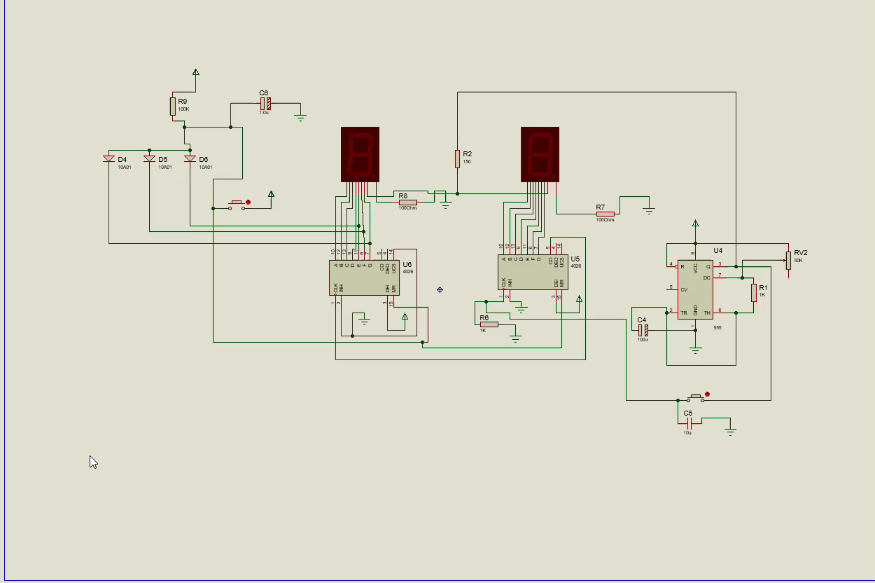
CIRCUIT DIAGRAM

Slide 7
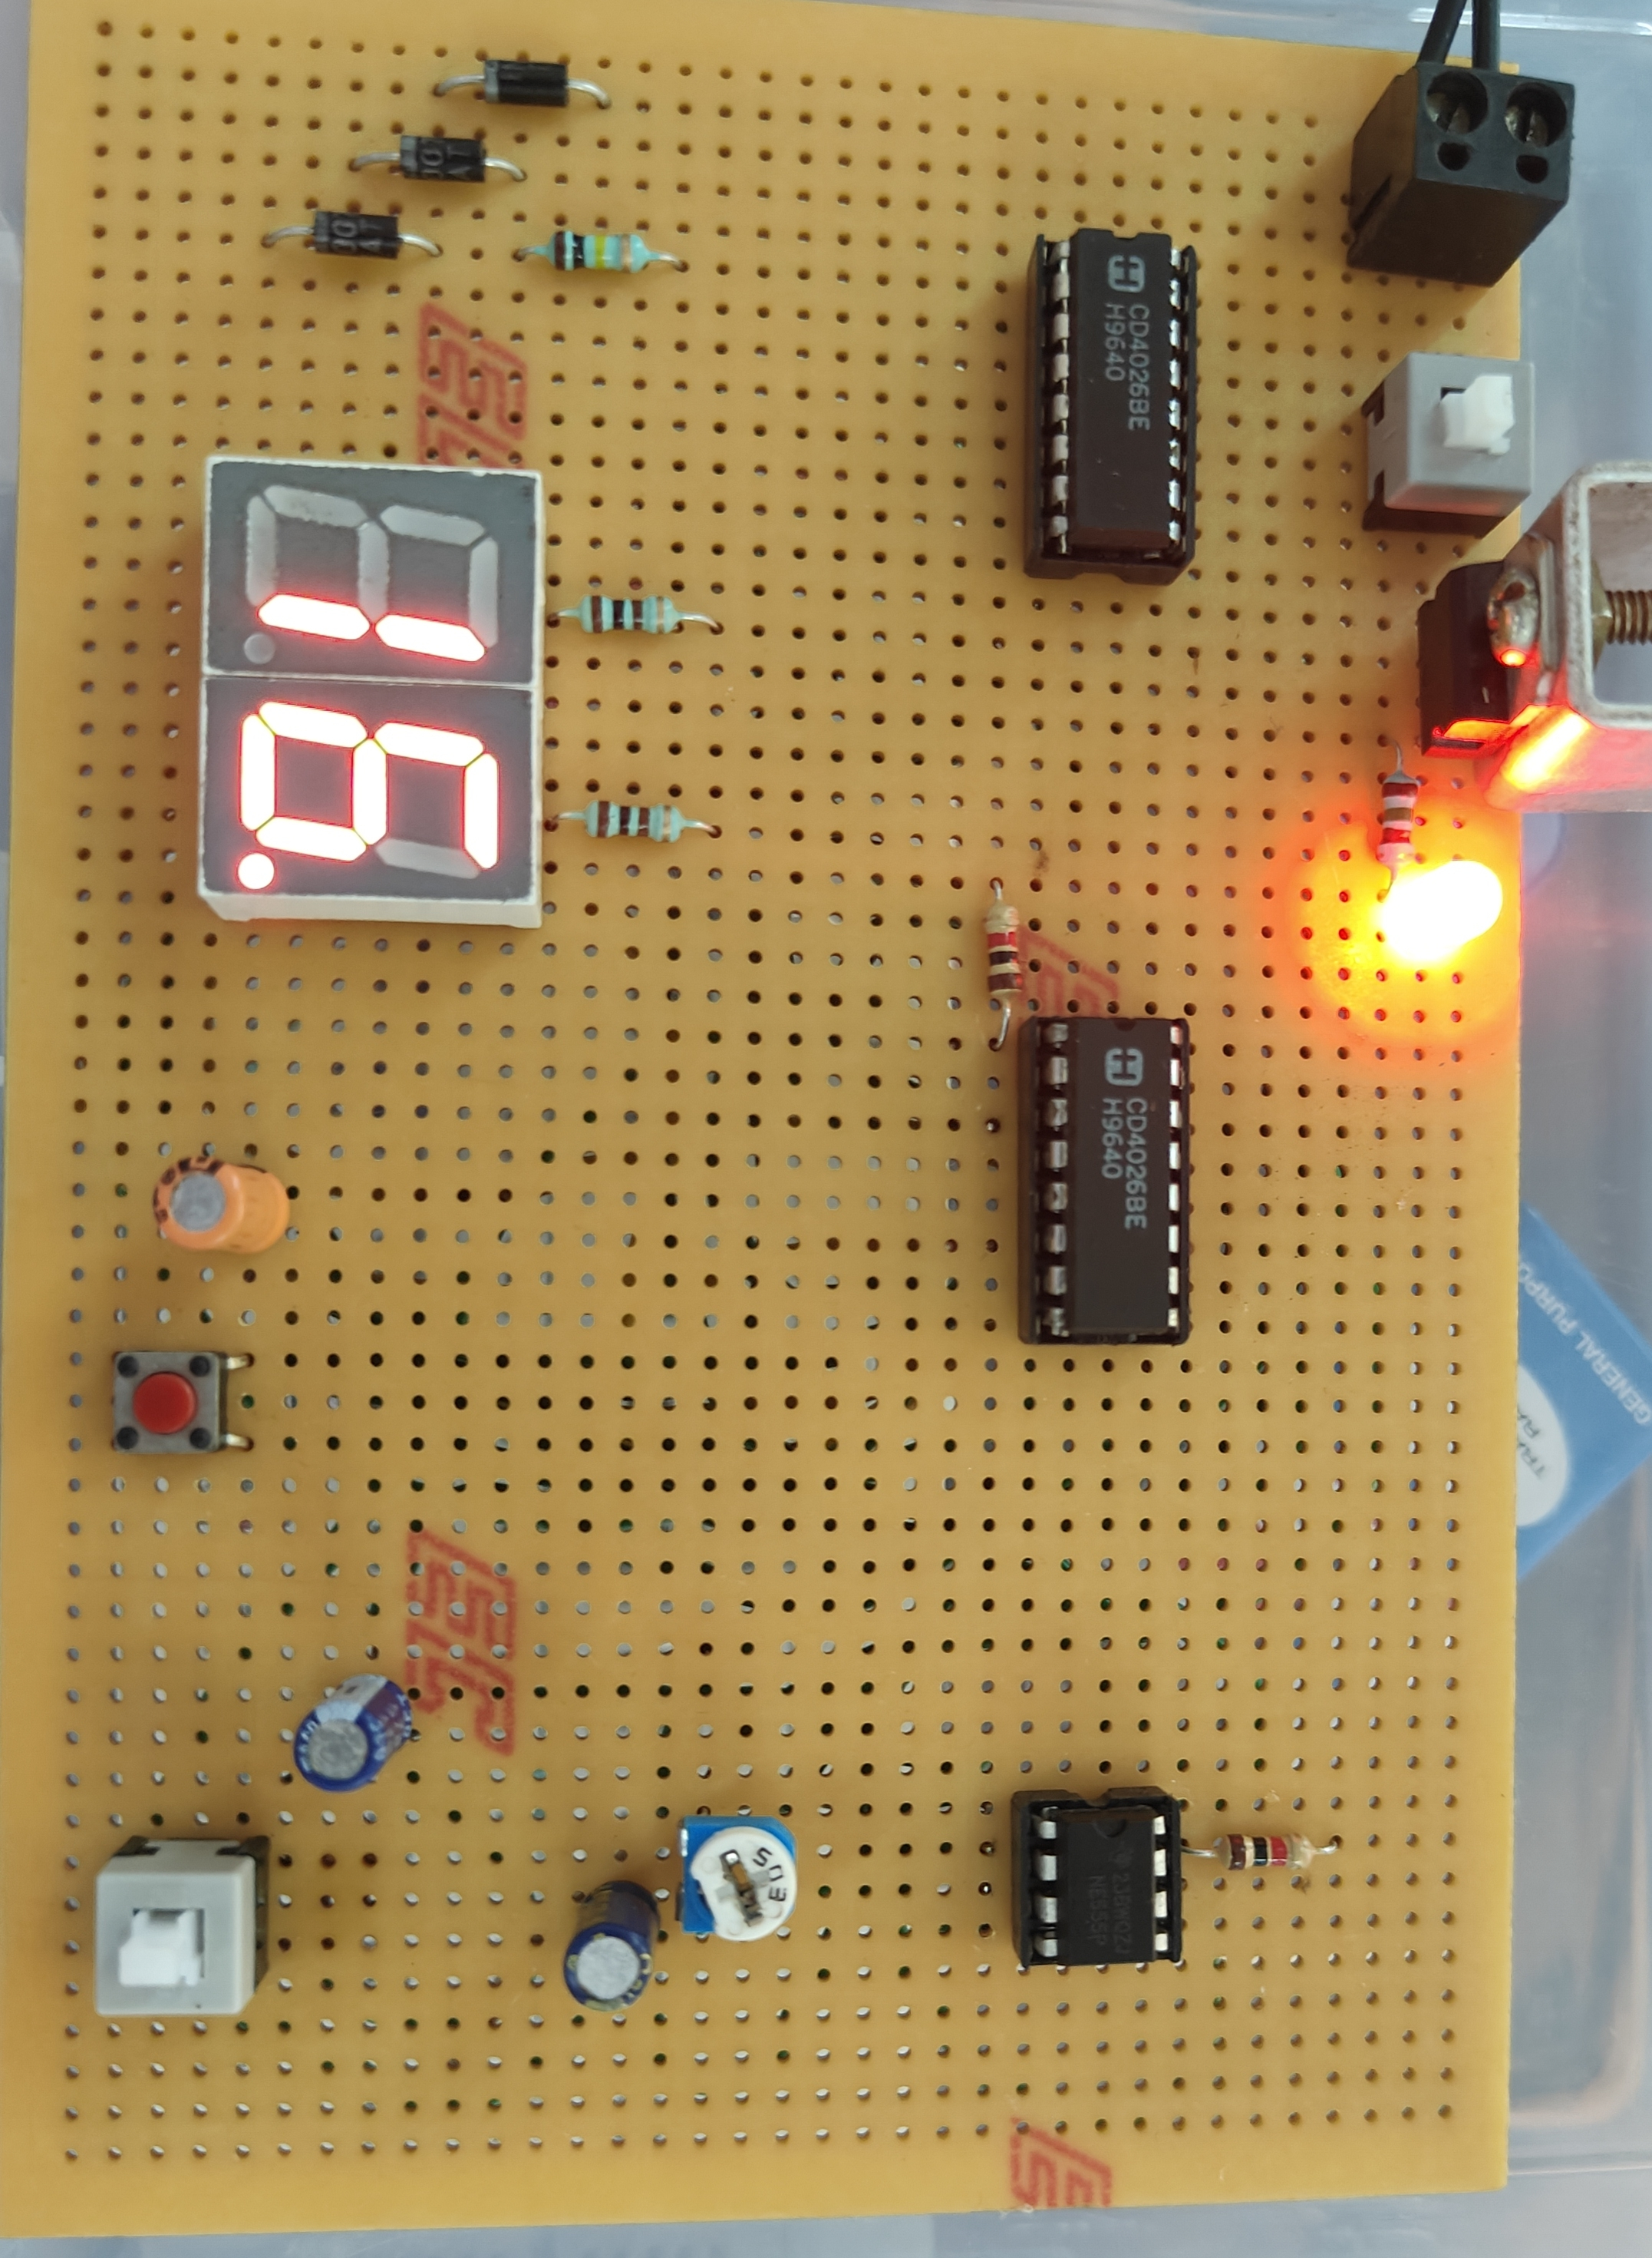
OUTPUT

Slide 8
Advantages and Applications
Advantages:
Simple and easy to build with minimal components.
Cost-effective for learning electronics and timer designs.
No microcontroller needed, purely IC-based.
Applications:
Educational purposes for learning digital electronics.
DIY projects for hobbyists.
A basic timer in simple timing tasks.

Slide 9
CONCLUSION
Summary:
The stopwatch successfully tracks time up to 99 seconds using IC 4026 and a 555 Timer.
Features Start/Stop and Reset functionality for better control.
Demonstrates a practical use case of ICs and basic components in circuit design.
Future Scope:
Expand to measure minutes by adding more 4026 ICs and displays.
Use a microcontroller (e.g., Arduino) for advanced functionality like lap timing.

Slide 10


